Slide 1





School of Computer Science and Engineering
Department of Computer Science and Engineering
Explainable Skin Lesion Classification using Fine-Tuned ResNet50 on HAM10000 Dataset
Submitted By:
Rashi Agarwal
2427030734
Supervised By:
Dr. Ashok Kumar Saini

Slide 2
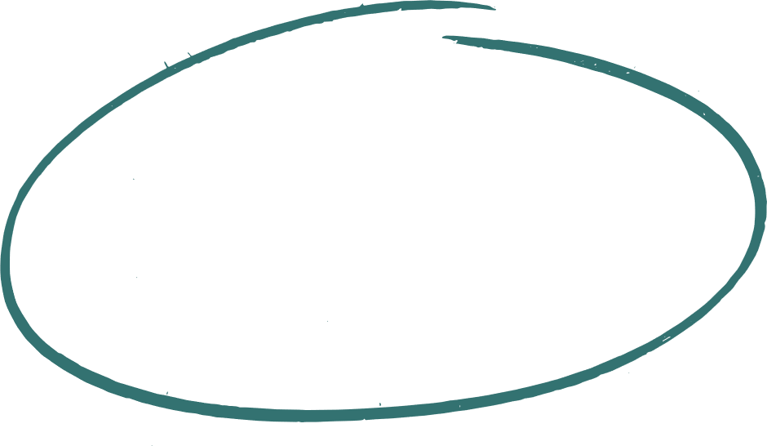

Outline:
Introduction
Literature Review
Problem Statement
Proposed Solution
Objectives
Results

Slide 3

Introduction
Skin cancer is among the most prevalent cancers globally.
Early melanoma detection significantly increases survival rates.
Manual dermoscopic diagnosis:
Requires domain expertise
Time-consuming
Prone to inter-observer variability
Deep learning provides automated, scalable diagnostic assistance.

Slide 4
Introduction
This project focuses on:
Binary classification (melanoma vs non-melanoma)
Using the HAM10000 dermoscopic dataset
Applying Transfer learning using ResNet50
Fine-tuning and hyperparameter optimization
Integrating explainability using Grad-CAM

Slide 5
Research Analysis
Deep Learning for Skin Cancer Classification (IEEE Access, 2022)
Objective:
Model & Techniques used:
Key Findings:
Limitations:
Conclusion:
Compare SOTA CNN architectures (ResNet50, EfficientNet‑B0, DenseNet) for dermoscopic classification.
ResNet50, EfficientNet‑B0, DenseNet
Transfer learning from ImageNet
Transfer learning significantly boosts performance vs training from scratch.
EfficientNet shows higher parameter efficiency.
Overfitting observed due to limited dataset size.
Model performance dropped when evaluated on external datasets (generalization issue).
Pretrained models improve learning on small datasets; require stronger regularization & augmentation for robustness.
Explainable AI in Medical Imaging (Nature Machine Intelligence, 2024)
Objective:
Model & Techniques used:
Key Findings:
Conclusion:
Assess necessity and techniques for explainability in medical AI.
Grad‑CAM
Saliency maps
Attention visualization
Interpretability directly influences clinician trust.
Grad‑CAM highlights decision‑relevant regions but is coarse.
Explainability is mandatory for clinical adoption; visualization must align with medical reasoning.

Slide 6
Research Analysis
Fine‑Tuned ResNet for Melanoma Detection (2021)
Objective:
Model & Techniques used:
Key Findings:
Limitations:
Conclusion:
Evaluate fine‑tuning vs frozen feature extractors for melanoma recognition.
ResNet50, partial layer unfreezing, Adam optimizer
Learning rate scheduling
Fine‑tuning improves validation accuracy (~90%).
Higher convolutional blocks critical for domain‑specific features.
Severe class imbalance causes recall reduction.
High early false negatives.
Fine‑tuning & careful scheduling improves adaptation, but class imbalance remains impactful.
Med Image Analysis Survey (2021)
Objective:
Model & Techniques used:
Key Findings:
Limitations:
Conclusion:
Survey transfer learning applications in medical imaging
Multiple CNN architectures
Pretrained weights for feature extraction
Pretrained models outperform training from scratch.
Transfer learning enhances learning with limited medical datasets.
Overfitting risk on small datasets
Fine-tuning with strong regularization and augmentation improves robustness in my project

Slide 7
Research Analysis
Deep Residual Learning for Image Recognition (He et al., 2016)
Objective:
Model & Techniques used:
Key Findings:
Limitations:
Conclusion:
Improve training of very deep neural networks
ResNet architecture with residual connections
Easier convergence in very deep networks
Improved feature extraction
Slightly higher computational cost
Adopted ResNet backbone for stable training and effective feature representation
MelanomaNet: Explainable System (2025)
Objective:
Model & Techniques used:
Key Findings:
Limitations:
Conclusion:
Explainable multi-class skin lesion classification.
EfficientNet-V2 backbone
GradCAM++ for visual explanations
Monte Carlo Dropout for uncertainty quantification
85.6% classification accuracy
Flags predictions with high uncertainty for clinician review
Limited pixel-level interpretability
Integrated layered explainability and uncertainty awareness into my model outputs

Slide 8

Problem Statement
To develop an accurate and explainable binary skin lesion classification system using transfer learning on HAM10000 that addresses class imbalance and interpretability challenges.

Slide 9

Objectives:
Implement transfer learning using ResNet50
Fine-tune model for improved accuracy
Integrate Grad-CAM for explainability
Analyze hyperparameter impact on performance

Slide 10
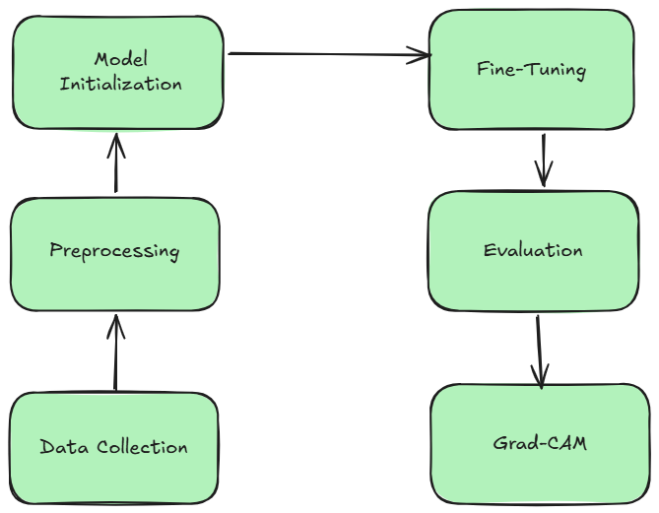
System Pipeline (Proposed Approach)

Slide 11
Proposed Methodology
Data Preprocessing (Proposed)
Resize images to 224×224
Normalize pixel values
Binary/multi-class label conversion
Data augmentation strategies (rotation, flip, scaling)
Train/Test split (80:20)
Note: Preprocessing plan is based on reviewed papers and best practices.

Slide 12
Proposed Methodology
Model Architecture (Planned)
Base: ResNet50 (ImageNet pre-trained)
Freeze lower layers, fine-tune top layers
Dense + Dropout layers for classification
Optimizer: Adam, learning rate tuning
Note: Architecture follows literature insights; implementation to be done in upcoming semesters.
Explainable AI (Planned)
Grad-CAM for visualization of lesion focus
Highlight medically relevant regions
Intended to validate model decisions visually
Note: Integration will be attempted after model implementation.

Slide 13
OUTCOME & FUTURE PLAN
Current Semester Achievements
✔ Completed comprehensive literature review.
✔ Short analysis of six major papers.
✔ Structured plan for preprocessing, architecture, and explainability.
✔ Drafted PPT summarizing insights and methodology.
Next Semester Targets
Begin practical implementation: preprocessing + model initialization
Draft a beginner-level research paper based on literature insights
Integrate Grad-CAM and experiment with hyperparameters
Plan for real-time deployment (Flask/GUI interface)

Slide 14
References:
H. L. Gururaj, N. Manju, A. Nagarjun, V. N. M. Aradhya and F. Flammini, "DeepSkin: A Deep Learning Approach for Skin Cancer Classification," in IEEE Access, vol. 11, pp. 50205-50214, 2023, doi: 10.1109/ACCESS.2023.3274848.
Pahud de Mortanges, A., Luo, H., Shu, S. Z., Kamath, A., Suter, Y., Shelan, M., ... & Reyes, M. (2024). Orchestrating explainable artificial intelligence for multimodal and longitudinal data in medical imaging. NPJ digital medicine, 7(1), 195.
ElGhany, S. A., Ibraheem, M. R., Alruwaili, M., & Elmogy, M. (2021). Diagnosis of Various Skin Cancer Lesions Based on Fine-Tuned ResNet50 Deep Network. Computers, Materials & Continua, 68(1).
Wang, J., Zhu, H., Wang, SH. et al. A Review of Deep Learning on Medical Image Analysis. Mobile Netw Appl 26, 351–380 (2021). https://doi.org/10.1007/s11036-020-01672-7
He, K., Zhang, X., Ren, S., & Sun, J. (2016). Deep residual learning for image recognition. In Proceedings of the IEEE conference on computer vision and pattern recognition (pp. 770-778).
Ilyosbekov, S. (2025). MelanomaNet: Explainable Deep Learning for Skin Lesion Classification. arXiv preprint arXiv:2512.09289.

Slide 15
Thank You

